Slide 1
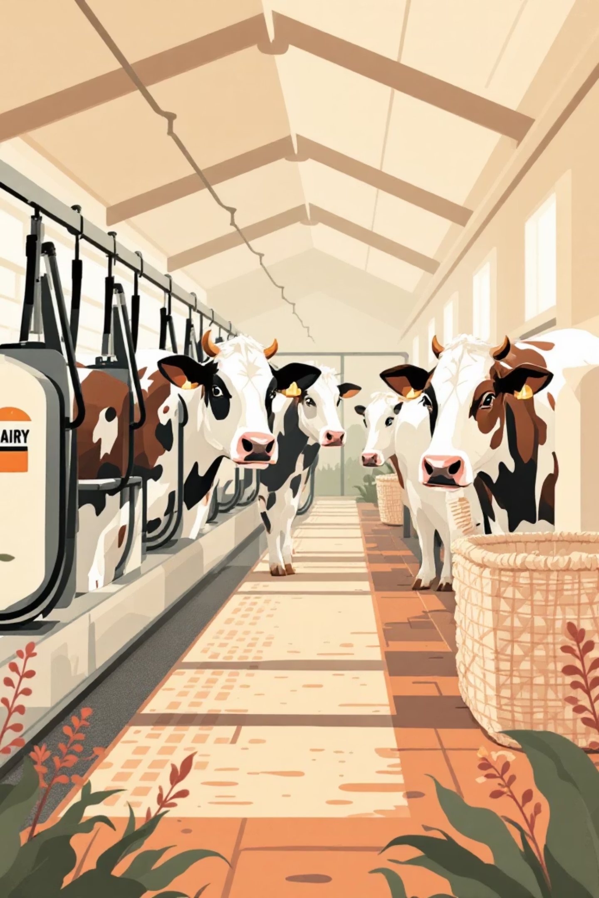
Smart Cow Milking Machine
An Innovative Digital Electronics Project for Automated Milk Collection

Slide 2

Introduction: Transforming Dairy Farming
The dairy industry serves as a vital backbone of the rural economy, providing livelihoods to millions of small-scale farmers. Despite its importance, most farmers continue to rely on traditional manual milking methods that are labor-intensive, time-consuming, and often compromise hygiene standards.
Existing automatic milking machines utilize sophisticated vacuum and pulsation mechanisms, making them prohibitively expensive and complex for small dairy operations. The maintenance requirements and technical expertise needed further limit their accessibility to rural communities.
The Innovation
Key Benefit
Our project introduces a simplified smart milking system that uses load cell-based weight measurement to automatically stop the motor once milk collection is complete.
Achieving automation at low cost with minimal complexity, making modern dairy technology accessible to small-scale farmers.

Slide 3

Problem Statement
Small dairy farmers across rural India encounter significant challenges that affect productivity, animal welfare, and economic sustainability. Understanding these problems is crucial to appreciating the need for an automated solution.
Labour-Intensive Manual Process
High Cost of Existing Solutions
Manual milking requires significant physical effort and time, with inconsistent results depending on the farmer's technique and fatigue level. This limits the number of animals a single farmer can manage efficiently.
Commercial automatic milking machines range from ₹50,000 to several lakhs, putting them beyond reach for small farmers. These systems also require regular maintenance and technical expertise.
Lack of Measurement Precision
Animal Health Concerns
No affordable method exists to automatically measure collected milk volume or weight, leading to estimation errors and potential disputes in milk collection centers.
Over-milking can harm animal health, cause stress, and reduce long-term milk production. It also wastes valuable energy and time without any productivity gain.
The Need: A low-cost, automatic milking solution that ensures precise control, automatic measurement, and protection of animal welfare.

Slide 4
Project Objectives
This project aims to bridge the gap between traditional manual methods and expensive automated systems by developing a practical, affordable solution for small-scale dairy operations.
01
02
Develop Automatic Weight-Based System
Implement Smart Auto-Stop Feature
Create an automatic milking machine that uses a load cell sensor to continuously monitor milk collection weight in real-time, eliminating the need for manual intervention.
Program the system to automatically stop the milking motor when milk flow ceases, detected by stable weight readings over a predetermined time period.
03
04
Ensure Cost-Effectiveness
Demonstrate Simplified Automation
Build a system that is affordable for small dairy farms, using readily available components and requiring minimal maintenance expertise.
Prove that dairy technology automation can be achieved using basic microcontrollers and sensors, without complex vacuum or pulsation mechanisms.

Slide 5
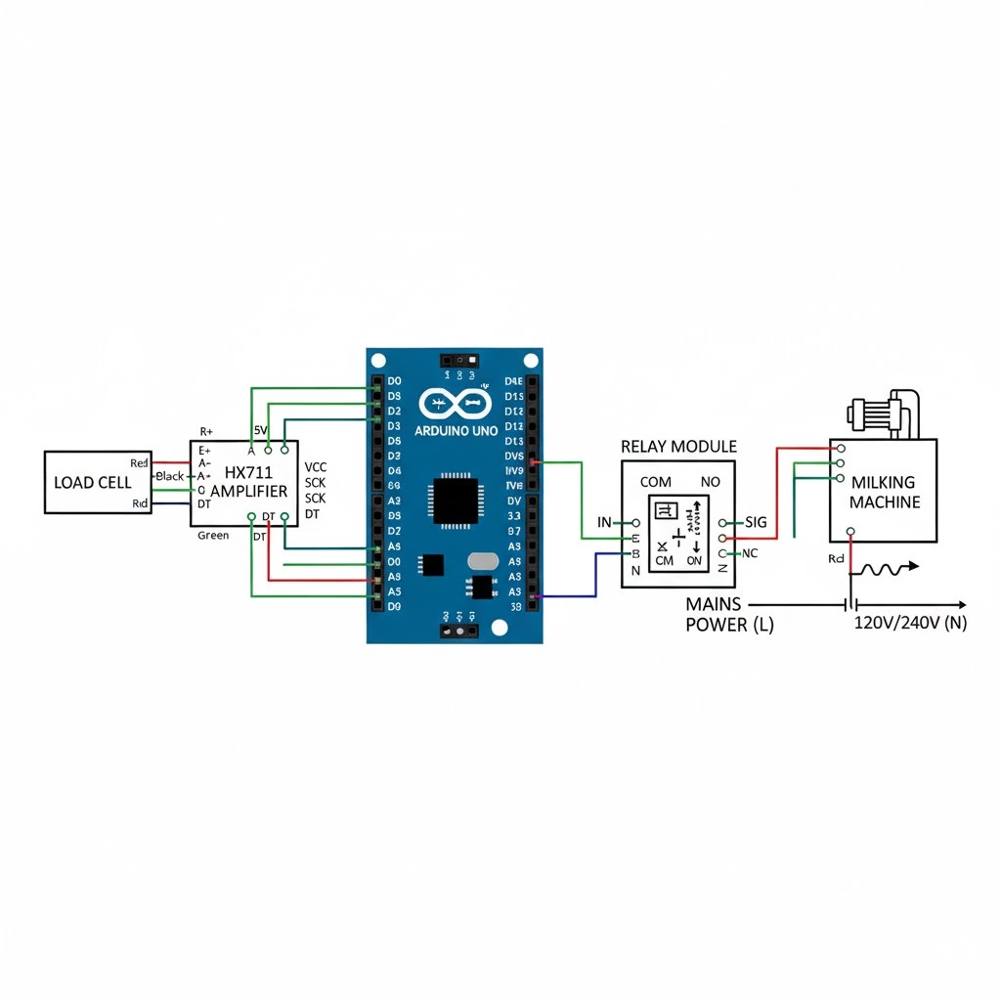



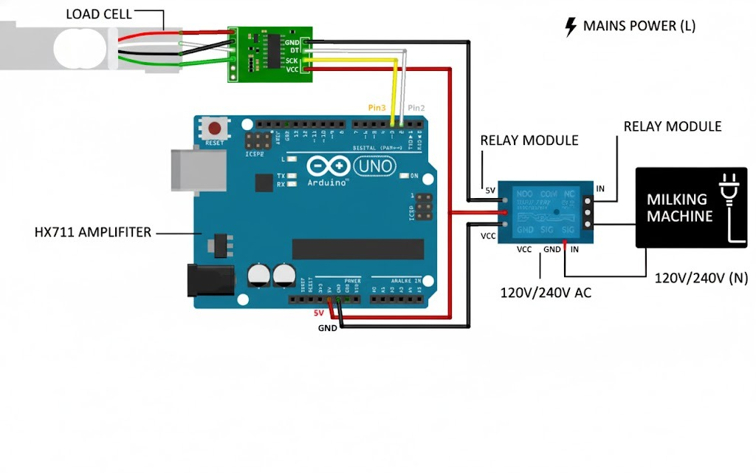


Proposed System Overview
System Architecture
Our innovative design eliminates the need for expensive vacuum-based milking mechanisms by focusing on weight-based detection. This fundamental shift in approach dramatically reduces both cost and complexity.
The system continuously monitors milk weight during collection. When the weight stabilizes—indicating milk flow has stopped—the Arduino automatically deactivates the motor through a relay module.
Key Innovation: Weight-based detection eliminates vacuum/pulsator mechanisms, reducing system cost by over 80%.
Load Cell Sensor
Mounted below milk collection tank to measure real-time weight with high precision
HX711 Amplifier
Converts small analog signals from load cell into readable digital data for processing
Arduino Uno
Microcontroller brain that processes weight data and executes control logic
Relay Module
Electronic switch that controls motor power based on Arduino commands

Slide 6
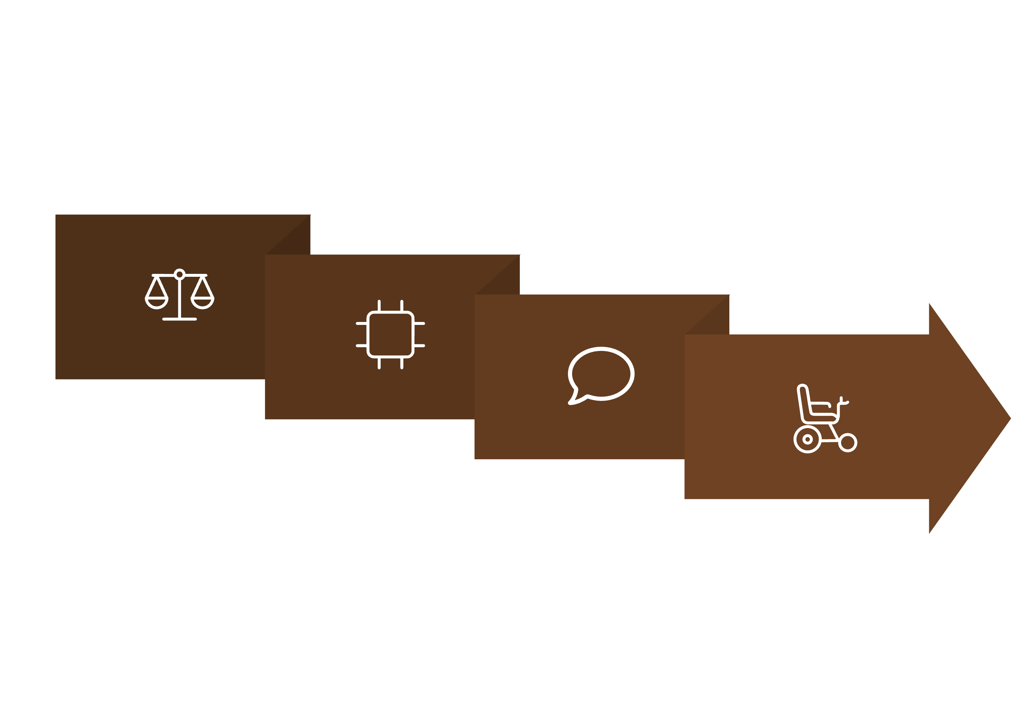
System Block Diagram
HX711 Amp
Relay → Motor
Working Principle
Load Cell
Weight Monitoring
Flow Detection
1
If weight remains constant for 5 seconds, system interprets this as milk flow stopping
Arduino reads current milk weight every few milliseconds through HX711 amplifier
Arduino Uno
2
3
4
Data Comparison
Auto Shutdown
Arduino deactivates relay, turning off motor automatically and safely
System compares new readings with previous values to detect weight changes

Slide 7
Circuit Design & Connections
Component Wiring Details
Load Cell to HX711
HX711 to Arduino
E+ (Excitation Positive) → Red wireE− (Excitation Negative) → Black wireA+ (Amplifier Positive) → White wireA− (Amplifier Negative) → Green wire
DT (Data) → Arduino Pin D3SCK (Clock) → Arduino Pin D2VCC → Arduino 5VGND → Arduino GND
Relay Module to Arduino
Motor Connection
IN (Control Signal) → Arduino Pin D8VCC → Arduino 5V or external 5VGND → Arduino GND
Motor Terminal 1 → Relay COMMotor Terminal 2 → Relay NO (Normally Open)Power Supply → Through relay to motor
Operation Logic
The HX711 module continuously sends amplified digital weight data to the Arduino. The microcontroller executes intelligent comparison logic: if the difference between current and previous readings remains negligible over multiple measurement cycles, the relay automatically switches off the motor. This ensures automatic shutdown based on actual milk collection completion, not arbitrary timers or manual intervention—providing both efficiency and safety.

Slide 8
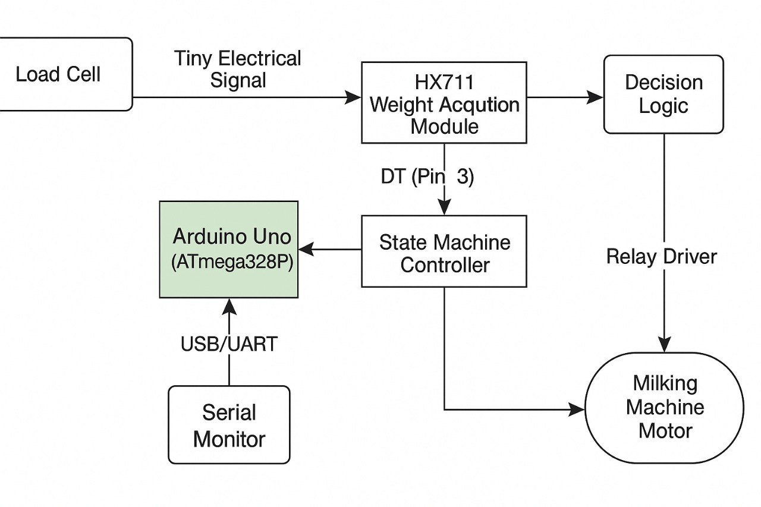
Hardware Components
Component
Specification
Function
Arduino Uno
ATmega328P
Main controller for processing sensor data and executing control logic
Load Cell
5–10 kg range
Measures milk weight with high precision during collection process
HX711 Module
24-bit ADC
Signal amplification and analog-to-digital conversion of load cell data
Relay Module
5V SPDT
Electronic switch for motor control based on Arduino commands
DC Motor/Pump
5–12V
Simulates milking mechanism (in actual implementation, drives milk pump)
Milk Collection Tank
Stainless/Plastic
Food-grade container for hygienic milk collection and storage
Power Supply
5–12V Adapter
Provides stable power to entire system including Arduino and motor
Physical Assembly
Load Cell Placement: Securely mounted beneath the milk collection container with proper mechanical isolation to prevent external vibrations from affecting readings
Control Circuit Housing: Arduino and relay circuit are mounted in a separate waterproof enclosure for safety and protection from moisture
Calibration Process: System is calibrated using certified known weights (100g, 500g, 1kg, 2kg) to ensure measurement accuracy within ±5g tolerance
Wiring Safety: All connections use proper gauge wiring with strain relief and protective sheathing

Slide 9

Results & Observations
±5g
100%
0
Measurement Accuracy
Auto-Stop Success
False Triggers
Load cell calibration ensures precise readings within a 5-gram tolerance range
System reliably detects milk flow cessation and stops motor automatically
Software debounce eliminates false relay switching for smooth operation
Testing Outcomes
✓ Weight Measurement
✓ Automatic Shutdown
System successfully measures milk weight in real-time with consistent accuracy across multiple test runs
Motor stops automatically when weight stabilizes for configured duration (3-5 seconds)
✓ Smooth Operation
✓ No Vacuum System
Relay switching occurs without arcing or mechanical stress, ensuring long component life
Automation achieved without expensive vacuum mechanisms, validating the cost-effective approach
Project Success: The system demonstrates a low-cost, practical, and reliable solution for small-scale dairy farmers, proving that sophisticated automation doesn't require complex or expensive components.

Slide 10

Advantages & Future Scope
Key Advantages
Future Enhancements
Full Automation
IoT Integration
Reduces human involvement, freeing farmers for other productive tasks
Add Wi-Fi/GSM for remote monitoring and cloud-based data logging
Cost-Efficient Design
Total component cost under ₹3,000 compared to ₹50,000+ for commercial systems
LCD Display
Real-time visualization of milk weight and system status
Accurate Measurement
Provides precise digital record of milk collected from each animal
Quality Sensors
Local Implementation
Temperature and quality monitoring for milk safety assurance
Uses readily available components that can be sourced and replaced locally
Commercial Prototype
Development for small-scale dairy cooperatives

Slide 11
Conclusion
This project successfully demonstrates a smart automatic milking machine that operates based on weight detection technology. The system automatically deactivates when milk flow ceases, ensuring operational efficiency, maintaining hygiene standards, and protecting animal welfare. By eliminating the need for complex vacuum setups, we've created an affordable solution specifically designed for rural dairy farmers.
The innovative concept holds significant potential for patent filing and academic research publication, as it successfully combines sensor-based automation with cost-effective engineering design principles. This project proves that accessible technology can transform traditional agricultural practices, bringing modern automation benefits to small-scale farmers who need it most.
Thank You
Smart Cow Milking Machine - Digital Electronics Project

